Slide 1
CAREER PATH
CAREER CHANGE

Slide 2

College Degree
No need for cyber security college degree
Masters degree helpful

Slide 3

Self Study
How much IT knowledge do you know?
Certification exams are challenging
Basics of Networking
Basics of Computer Security
Basics of Web development

Slide 4
Self Study
IP & MAC addresses
Switches, routers & hubs
Ethernet
HTTP, HTTPS, TLS/SSL
TCP/IP
OSI Model
Domain Name System
DHCP
Ports
Malware
Antivirus, firewalls, IDS, IPS, encryption, biometrics
Hacking methodology
Phishing, sql injection, brute force attacks, ransomware etc
Social media & privacy issues
VPNs,Tor & Anonymizers
HTML, CSS
How web servers work
Basics of databases

Slide 5
Self Study Materials
Comptia security+ certification
Comptia network+ certification
CCNA certification
Online courses for basics of cyber security and web development

Slide 6
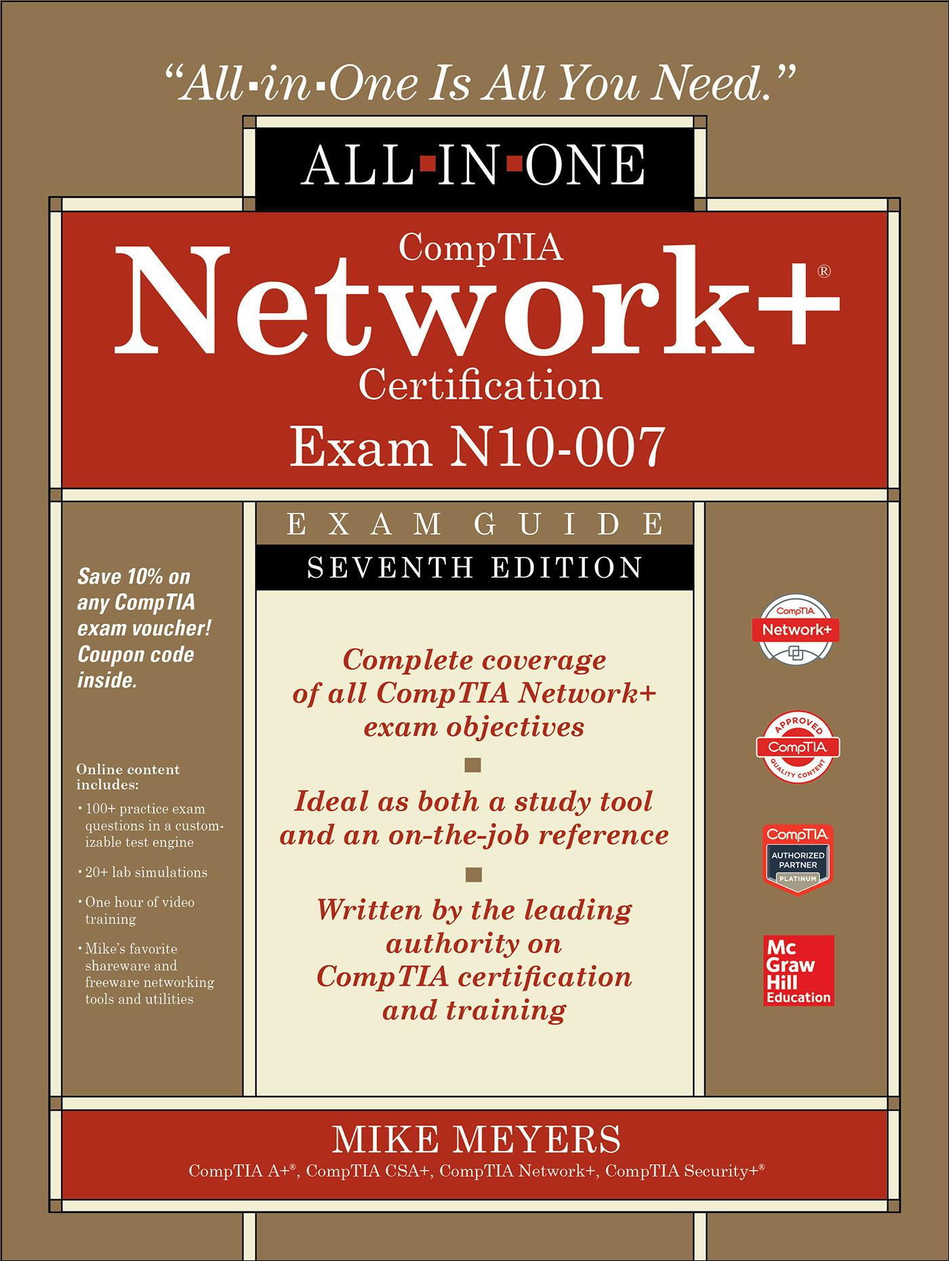
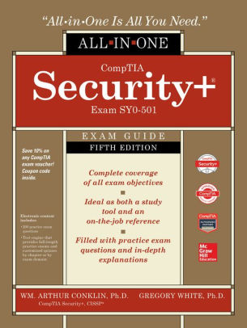
Self Study Materials
CBT Nuggets training videos

Slide 7
Decision Time
Do your research - what do you like?
Private sector or public sector
Security clearance?
Decide what field you want to go for
Write certification exams
Apply for jobs
Security analyst role?

Slide 8
Work Experience
Graduate
Start applying for jobs - security analyst
Gain certifications for specialization i.e CEH, CFA, CISSP
Grow your career

Slide 9

Huge Demand

Slide 10

Learning never stops

